Slide 1















Steam Recommendation System & Sentiment Analysis
Presented by:
Hatem Yousef,Wael Walid,Jamal Yaser,Ghufran Mahmoud

Slide 2
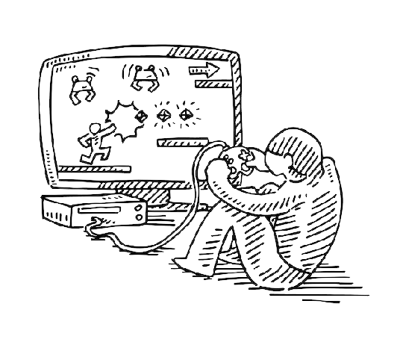
Overview
The gaming industry has been growing rapidly in recent years; the global video game industry was worth over $197 billion in 2022 which presents a significant increase compared to 2020 when the global market was valued at about $155 billion.
Developers added 10,263 games to Steam in 2020. That’s a record number of games released on the platform. And it was an increase of 27.76% over the previous year.

Slide 3
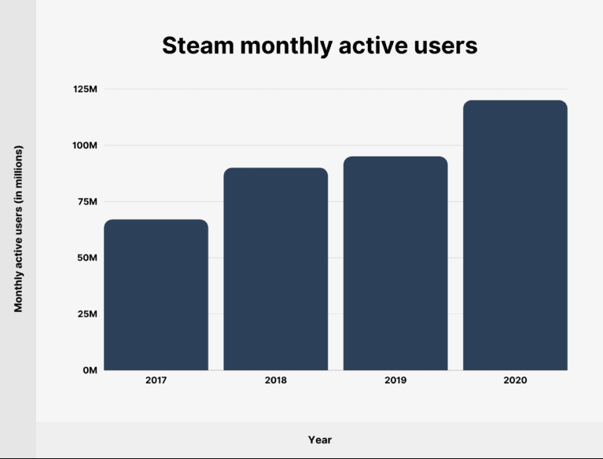
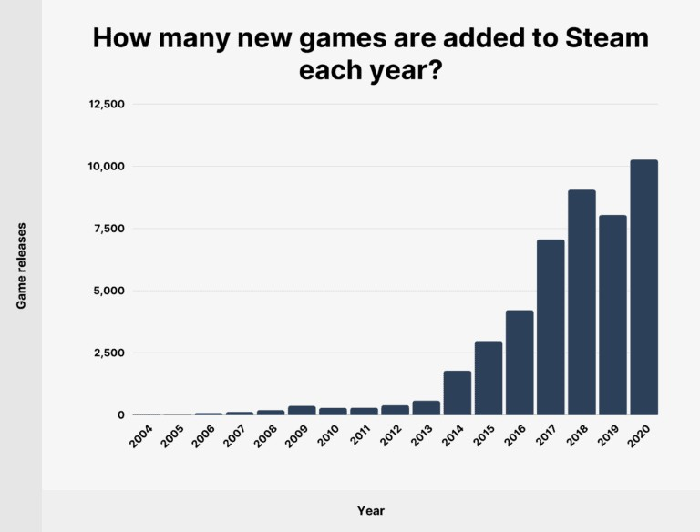
The gaming industry is growing rapidly

Slide 4
Challenges in Discovery and Insight Extraction
01.
User reviews play a pivotal role in guiding purchase decisions and shaping perceptions of game quality
02.
Understanding the underlying themes and issues can provide valuable insights for developers to address shortcomings
As the number of available games on platforms like Steam continues to grow, users often encounter difficulty in navigating through the millions of games to discover titles that align with their preferences.
Also the number of reviews left by the users also increased drastically, some game could have up to millions of reviews, so
it became difficult for developers or users to get meaningful insights
03.
Helping developers to hear their user-base so they can make informed decisions and improvements

Slide 5
Key Characteristics
01
02
03
User-Centered Design
Advanced Analysis
Engaging and Personalized

Slide 6
Goals
01
02
03
Develop a Recommendation System.
Create a Chatbot Interface
Provide Developer Tools to Get Insights

Slide 7



Data Sources
Steam API
SteamSpy API

Slide 8

Data Understanding
Each app in Steam store have a unique ID, although some apps might have the same name, they could never have the same app ID.
This will be very helpful in identifying apps, and will eventually help us merge our data tables.

Slide 9

Data Collecting
Retrieving all the data at once might not be a good idea
Download the data in batches

Slide 10


Steam API games data: “descriptions”, “media”,“PC requirement”,”game name”
“date of release”, etc.....
SteamSpy API games data: “game name”,”publisher”,”count of negative reviews/positive”, etc....
Data Retrieved
Exploring data
Steam API reviews data: “review text”,“type of the review”,”time played before leaving a review”, etc....

Slide 11
Data Preprocessing
Data preprocessing and cleaning are essential steps to prepare data for analysis, ensuring that the dataset is accurate, consistent, and ready for further processing.
Data cleaning is often referred to as the lengthiest part of any project. So, we will break it up into sections

Slide 12
Data Preprocessing
important steps
Dealing with null values
Ensuring consistency & proper format
Dealing with duplicates
(since every app have a unique id)
Remove irrelevant data

Slide 13

Recommendation System
TF_IDF
matrix
Raw data
Cosine similarity
Similar
games

Slide 14

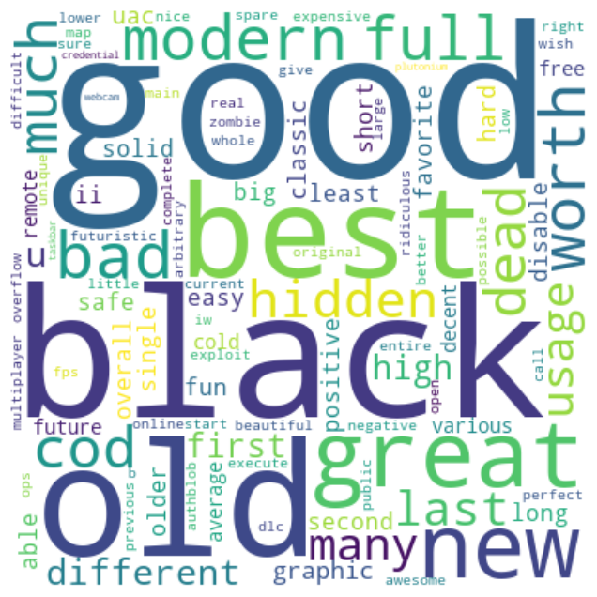


Word Cloud
Preprocessed reviews
Tokenization
Count words

Slide 15
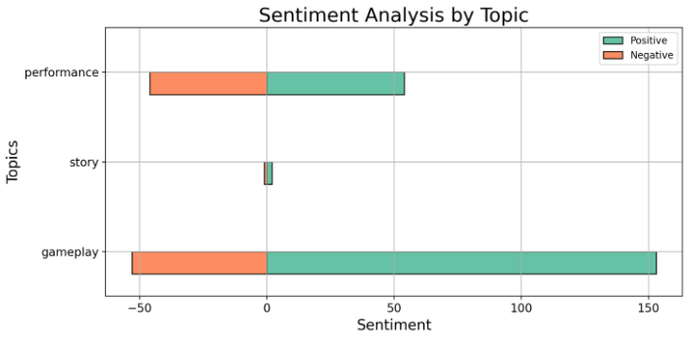
Sentiment By Topic
Preprocessed reviews
Tokenization
Checking
keywords

Slide 16







RAG Pipeline
Data
CSV
loader
Pinecone
Embedding Generator
Vector Database
User query
Query
+
Context
LLM
Response

Slide 17
References
https://backlinko.com/steam-users

Slide 18
Thank you very much!

